Slide 1
PDAT613G: Data Mining
Module 1 – Introduction

Slide 2
01 – Data Science Certificate
PDAT 610G – Introduction to Data Science
PDAT 611G – Big Data Management
PDAT 613G – Data Mining
PDAT 615G – Machine Learning
PDAT 620G – Data Science Capstone

Slide 3
02 – Overview of 613G: Data Mining
The course is split into 3 modules:
Module 1: Overview of Data Mining
Module 2: Models (Supervised vs Unsupervised Learning)
Module 3: Conceptual Components (Visualization, NLP, Ethics)

Slide 4
03 – What is Data Mining
Data mining is the automated process of sorting through large data sets to discover actionable information and patterns, and establish relationships.
Data mining is one of the first steps in the data science process.
Data mining is a field in which we try to identify patterns in data and come up with initial insights.
Data mining is a cross-disciplinary field that focuses on discovering properties of data sets, while machine learning is a sub-field of data science that focuses on designing algorithms that can learn from and make predictions based on data.

Slide 5
04 – What is Data Mining
Data mining can broadly be classified into the following:
Descriptive analytics – What has happened in the past?
Predictive analytics – What will likely happen in the future?
Prescriptive analytics – What is the best next course of action?

Slide 6
05 – Question
Which of the following is not a true statement about data mining?
Data mining is a field in which we try to identify patterns in data and come up with initial insights.
Data mining is the process of sorting through large data sets to discover actionable information and patterns, and establish relationships.
The major task of data mining is to create a descriptive power and not create a predictive power.
None of the above.

Slide 7
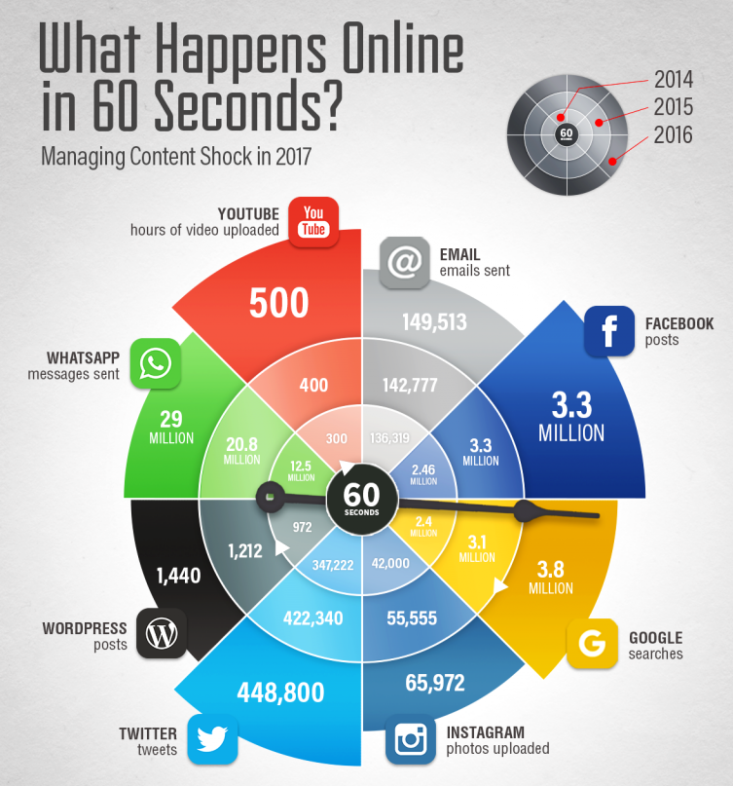
06 – Why Mine Data
In this day and age, data is produced at a phenomenal rate.
Our ability to store data has grown.
Users expect more sophisticated information.
Basically, we are drowning in data but starving for knowledge.

Slide 8
07 – Question
One zettabyte of data is equal to which of the following?
One million gigabytes
One billion gigabytes
One trillion gigabytes
One zillion gigabytes

Slide 9
08 – How Data Mining is Being Used
To Survive in Tough Times, Restaurants Turn to Data Mining
Data Mining 100 Million Instagram Photos Reveals Global Clothing Patterns
Profit from the Gold Rush in Data Mining

Slide 10
09 – Question
Based on your reading, what is the primary reason that our capacity for generating, storing, and analyzing data has exploded in recent years?
The internet
Faster computers
More computers
Longer work days

Slide 11
10 – What Is NOT Data Mining
Data mining is NOT about dividing the customers of a company according to their gender, but the task of data mining IS about finding groups of people with similar preferences.
Data mining is NOT about creating a graph of the number of people with lung cancer based on the number of cigarettes smoked per day, but data mining IS about predicting the chance of getting lung cancer based on the number of cigarettes smoked per day.

Slide 12
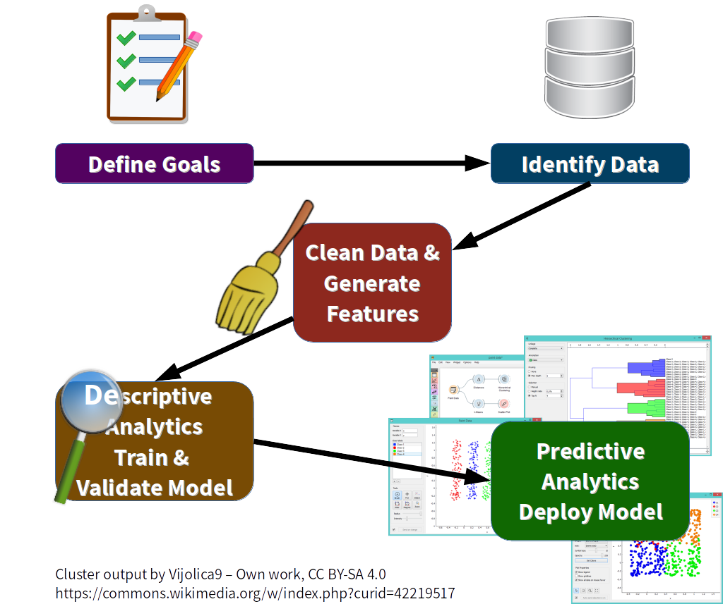
11 – Data Mining Tasks/Workflow

Slide 13
12 – Question
Which of the following is not a typical data mining task?
Define goals
Develop surveys
Clean data
Train and validate models

Slide 14
13 – Examples of Data Mining
Wal-Mart – Utilizes information on store footfall, advertising campaigns, and weather forecasts to predict sales and stock up accordingly.
Credit Card Companies – Mine transaction records for fraudulent use of their cards based on purchase patterns of consumers and deny access as necessary.
Human Genome Project – The field of bioinformatics processes piles of data to develop new drugs and weed out diseases.

Slide 15
14 – Challenges in Data Mining
Poor data quality, missing values, and poor sampling.
Lack of end-user understanding of the data and business problem.
Variety – accommodating data coming from various sources (audios, videos, text, sensors, etc.).
Velocity – speed of data updates and processing (users on Facebook upload more than 900 million images per day).
Volume – size of the data.

Slide 16
15 – Question
Which of the following is not a challenge in data mining?
High volume of data
High velocity of data
High variety of data
None of the above

Slide 17
16 – Statistical Modeling
Statistical models are used for:
Identifying patterns in data.
Classifying events.
Identifying influences of input variables.
Quantifying strength of evidence.

Slide 18
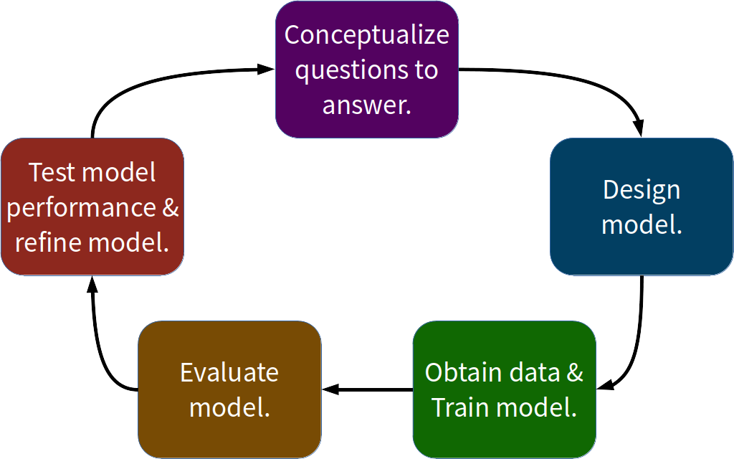
17 – Statistical Modeling Workflow

Slide 19
18 – Examples of Statistical Modeling
Market Segmentation/Customer Profiling
Predictive Modeling
Risk Modeling
Time Series Analysis
Recommender Systems

